Slide 1


2023
Benefits Orientation

Slide 2




The Four Pillars of Well-Being

Slide 3
Benefit Eligibility
All regular (FT or PT) employees working >21 hours per week may enroll in healthcare and voluntary coverage in the BenefitsPlus plans. Benefits are centralized across all brands at dentsu – all employees have access to the same coverages/programs
Coverage is always effective on the 1st of the month coincident or immediately following your date of hire.
Eligible employees may also enroll in coverage for dependents:
Spouse
Same or opposite sex domestic partner
Children
Domestic partner’s children

Slide 4
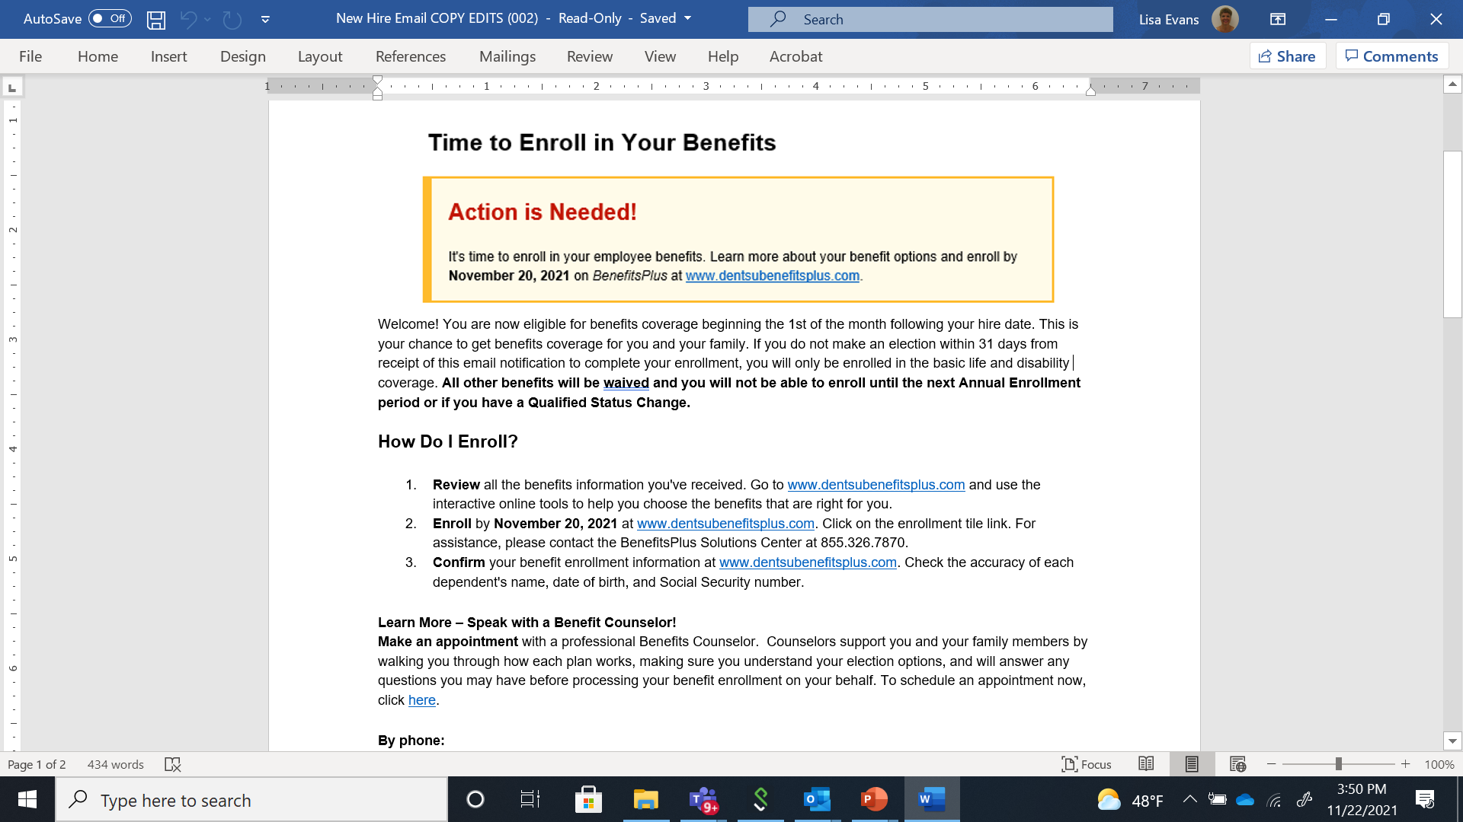
Benefit Enrollment
You will receive an email from BenefitsPlus (BenefitsPlus@alight.com) with instructions on how to enroll in coverage through the benefit portal.
You will have 31 days to enroll in coverage. If you do not enroll in benefits, you will be automatically waived from all voluntary insurance.
Your next opportunity to enroll will be during our next annual enrollment period unless you experience a mid-year life event.
Call the BenefitsPlus Solution Center for assistance at 855.326.7870

Slide 5
Benefit Counselors
You have the opportunity for a personal, one-on-one session with a professional Benefits Counselor!
Counselors support you and your family by walking you through how each plan works, making sure you understand your election options, and answering your questions
The counselor will also process your benefit enrollment on your behalf
To schedule your appointment, go to dentsu.myenrollmentinfo.com

Slide 7
The Lingo
Deductible
The amount you are required to pay for a claim before the plan begins covering expenses
Premium
The amount it costs to be enrolled in coverage, taken from your paycheck as a pre-tax deduction
Coinsurance
The amount you are required to pay for non-copay eligible services before the plan begins to cover the cost of care.
Copay
The total out of pocket cost you pay for certain services at your PCP, Specialist, or Urgent Care Center. Not every plan has copays.
Out Of Pocket (OOP) Max
The most you will be required to pay for healthcare costs (minus premiums) in a given plan year.

Slide 8

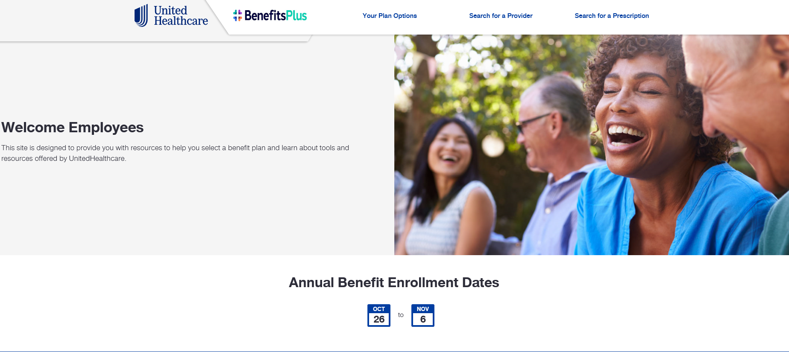
UHC Medical Plans
You have four plan options – 2 PPO plans, 2 HDHP plans - available through the Choice Plus Network to choose from for 2023.
All plans cover the same services, and the only difference is how much you pay versus how much the plan pays
Visit the UHC PreMember Website to review your plan options (medical, pharmacy &financial protection plans), search for providers, access your digital ID card and more! https://www.whyuhc.com/benefitsplus
More
Impact
More
Acceleration
More
Opportunity

Slide 9
Medical Plan Comparison
Features | Enhanced PPO | Standard PPO | Classic HDHP | Value HDHP
Preventive care (visits & tests) | Covered at 100% | Covered at 100% | Covered at 100% | Covered at 100%
Your monthly premiums | Highest | Mid-range | Lower | Lowest
Copays for common services & prescription drugs | ✓ | ✓ | × | ×
No cost preventive drugs (limited) | × | × | ✓ | ✓
Coinsurance (in-network) | 10% (plan pays 90%) | 20% (plan pays 80%) | 20% (plan pays 80%) | 20% (plan pays 80%)
Deductible (in-network) (individual/ family; applies to services with coinsurance, such as specialist office visits and out-of-network care) | Lowest $500/$1,000 | Lower $1,000/ $2,000 | Mid-Range $2,000/$4,000 | Highest $4,000/$8,000
Embedded Deductible and OOP* | ✓ | ✓ | × | ✓
HSA Eligible? | × | × | ✓ | ✓
dentsu HSA contributions | × | × | $500/$1,000 | $750/$1,500
* Embedded means one individual within a family will never pay more than the single deductible or single out of pocket maximum (OOP) amount

Slide 10
Medical Plan Design Comparison
Semi-Monthly Premiums | Enhanced PPO |  | Standard PPO |  | Classic HDHP | Value HDHP
EE Only | $119.50 |  | $78.00 |  | $47.50 | $33.50
EE + Spouse/DP | $276.00 |  | $200.50 |  | $136.50 | $104.50
EE + Child(ren) | $233.50 |  | $123.50 |  | $104.00 | $79.50
Family | $430.00 |  | $310.00 |  | $209.50 | $150.00
Plan Features
 | Network |  | Network |  | Network | Network
Deductible | $500/$1,000 |  | $1,000/$2,000 |  | $2,000/$4,000 | $4,000/$8,000
Coinsurance | 10% |  | 20% |  | 20% | 20%
OOP Max | $4,500/$9,000 |  | $4,500/$9,000 |  | $4,500/$7,000 | $6,900/$13,800
HSA ER Contribution | None |  | None |  | $500 Individual/$1,000 Family | $750 Individual/$1,500 Family
Copayments
Virtual Visit | $0 | Ded & Coin. | $0 | Ded & Coin. | Ded & Coin. | Ded & Coin.
PCP | $30 | Ded & Coin. | $30 | Ded & Coin. | Ded & Coin. | Ded & Coin.
Specialist | $50 | Ded & Coin. | $50 | Ded & Coin. | Ded & Coin. | Ded & Coin.
Rx Coverage*
Tier 1 | $10 | Ded & Coin. | $10 | Ded & Coin. | Ded & Coin. | Ded & Coin.
Tier 2 | $50 | Ded & Coin. | $50 | Ded & Coin. | Ded & Coin. | Ded & Coin.
Tier 3 | $75 | Ded & Coin. | $75 | Ded & Coin. | Ded & Coin. | Ded & Coin.
* Embedded means one individual within a family will never pay more than the single deductible or single out of pocket maximum (OOP) amount

Slide 11
Prescription Drug Tips
Rx Coverage | Enhanced PPO |  | Standard PPO |  | Classic HDHP | Value HDHP
Tier 1 | $10 | Ded & Coin. | $10 | Ded & Coin. | Ded & Coin. | Ded & Coin.
Tier 2 | $50 | Ded & Coin. | $50 | Ded & Coin. | Ded & Coin. | Ded & Coin.
Tier 3 | $75 | Ded & Coin. | $75 | Ded & Coin. | Ded & Coin. | Ded & Coin.
If you have a prescription for a maintenance medication (such as birth control, high blood pressure, insulin, etc.), you will be required to fill them through the Retail 90 program at Walgreens or Optum’s mail order program.
Visit the pre-member website to learn about the copays for your medications and lower cost alternatives.

Slide 12

UHC Tools & Resources
Download the UnitedHealthcare mobile app on your smart phone or tablet for the easiest access to tools and resources on-the-go relating to your medical insurance, including:
ID Card
Virtual Visit Benefits
Finding Network Doctors
Claims History
More
Impact

Slide 13
Other UHC Programs
Kaia gives you access to personalized digital programs to help with chronic musculoskeletal pain - including back, hip, and knee pain. Kaia is available at no additional cost. Download the Kaia mobile app to learn more.
2nd MD connects you with board-certified doctors across the country for an expert second opinion via video or phone within 3-5 days. Program participants will receive a $200 gift card from dentsu. Download the 2nd MD mobile app or call 866.841.2575 to get started.
Maven This program has expanded to provide you with support for preconception and fertility, adoption, surrogacy, postpartum, pediatric support, and much more!
Real Appeal is an effective science-based weight loss program with online group sessions led by coaches and a caring support community of members. Participants will receive a Success Kit with tools and resources including food scales, exercise equipment, food guides and more! Visit realappeal.com for more information.
More
Impact
More
Acceleration
More
Opportunity
Available to those enrolled in dentsu’s UHC medical plans!
For more information on these resources, visit: https://www.whyuhc.com/benefitsplus

Slide 14
Virtual Visits
Available to PPO members at $0 cost – HDHP members can utilize the benefit for less than $50
More
Impact
With UHC virtual visits, you can connect to board-certified physicians and save time instantly to discuss non-emergent conditions.
Video chat with a board-certified doctor on your mobile device, tablet or computer.
Doctors can give you a diagnosis and even write you a prescription if needed
No appointments necessary, visits take 10-15 minutes, and are available 24 hours a day, 7 days a week
Register at uhc.com/virtualvisit
More
Acceleration
More
Opportunity

Slide 15

One Medical
One Medical is near-site primary care that provides same and next day appointments
Providers participate in the UnitedHealthcare network
Connect you your provider 24/7 through the mobile app
Membership fee waived for employees in New York City, Boston, Chicago, Los Angeles, San Francisco, Austin and Atlanta
Sign up at onemedical.com/myhealth, use code DNTONE
More
Impact
“I had a wonderful first experience. Facility was super clean and nice. Appointment was easy to make, quick and seamless process. Not a thing I would change!”
More
Acceleration
More
Opportunity
Employee Feedback

Slide 16
Health Saving Accounts (HSA) & Flexible Spending Accounts (FSA)
Health Savings Account (HSA)
Healthcare Flexible Spending Account (HCFSA)
Dependent Care Flexible Spending Account (DCFSA)
  Administered by Optum Bank for HDHP enrollees only
  You contribute pre-tax dollars to the account
  Funds are available upon deposit
  Company contribution:
    Classic HDHP: $500 single / $1,000 family
    Value HDHP: $750 single / $1,500 family
  Can be used for OOP eligible health care expenses
  Any unused funds will roll over to the following year
  Administered by SmartChoice for all benefit eligible employees not enrolled in a HDHP plan
  You contribute pre-tax dollars to the account
  Annual election available immediately
  No company contribution
  Can be used for OOP eligible health care expenses
  You will forfeit unused balances greater than $610 at the end of the year
  Administered by SmartChoice for all benefit eligible employees
  You contribute pre-tax dollars to the account
  Funds are available upon deposit
  No company contribution
  Can be used for dependent day care
  You will forfeit any unused balances at the end of the year

Slide 17
Delta Dental Plans
Semi-Monthly Premiums | Standard |  | Enhanced
EE Only | $7.00 |  | $11.00
EE + Spouse/DP | $13.00 |  | $21.50
EE + Child(ren) | $14.00 |  | $24.50
Family | $19.50 |  | $34.50
Plan Features
 | Network | Out of Network | Network | Out of Network
Deductible | $50 | $150 | $50 | $150
Annual Maximum | $1,000 |  | $2,000
# of Preventative Visits | 2 |  | 3
Coverage
Preventative | 100% | 100% | 100% | 100%
Basic | 80% | 80% | 100% | 80%
Major | 50% | 50% | 60% | 50%
Orthodontia | Not covered |  | 50% up to $2,000 (lifetime)
More
Impact
Your annual maximum is the most your plan will pay towards your dental services in a year and applies to each covered person
Orthodontia coverage with a lifetime maximum of $2,000 for Enhanced plan members only
Access to dentists within two provider networks for better cost savings
Tip: request a pre-treatment estimate before receiving services to know cost ahead of time
Download the Delta Dental Mobile app or visit www.deltadentalins.com for easy access to your coverage, claims, and ID cards
More
Acceleration
More
Opportunity
Definitions:
Preventive services- exams, cleanings, etc. (the deductible does not apply to these services)
Basic Services- oral surgery, fillings, etc.
Major Services- crowns, dentures, etc.

Slide 18
Vision Plan
Semi-Monthly Premiums
EE Only | $4.08
EE + Spouse/DP | $8.17
EE + Child(ren) | $8.74
Family | $13.79
Plan Features | Network | OON
Exam (Annual) | $10 copay | Up to $45
Lenses (Annual) | $25 copay | Reimbursements range $30-$75 based on lens type
Frames (Annual) | $200 allowance + 20% amt over allowance | Up to $50
Elective Contacts (Annual) | $160 allowance | Up to $100
Laser Vision Correction | 15% off regular price or 5% off promo price | Not Covered
More
Impact
One plan available to all employees
Visit in-network providers to maximize this benefit
Plan covers annual eye exam, frames and lens fitting
Visit eyeconic.com for a virtual “dressing room” to try on your eyewear before you order - the latest deals and promotions on eyewear and contact lenses are available through Eyeconic
Download VSP Vision Care On the Go to check your coverage, find your vision provider, and shop eyewear
More
Acceleration
More
Opportunity

Slide 20
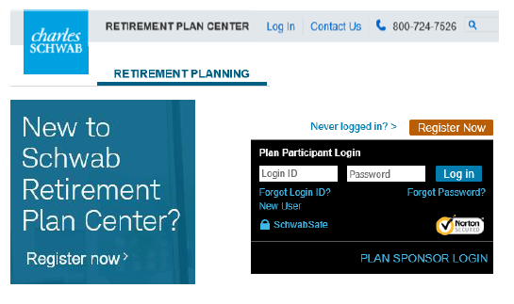
401(k) Plan
All regular full-time employees are immediately eligible to participate
You can make changes to your contributions year-round
Contribute up to 75% of your salary up to IRS limits on pre-tax or Roth deductions
50% employer match up to the first 6% of eligible pay
Vesting Schedule:
0-1 YOS: 0%
1-2 YOS: 33%
2-3 YOS: 66%
3+ YOS: 100%

Slide 21
Financial Support Programs
SofiAtWork
SoFiAtWork specializes in student loan debt management. Using this platform, you can access a personalized debt navigator, advice for your repayment options, and receive a discounted refinancing rate.
Key Features Include:
Online budgeting tool
Personalized savings recommendations
Financial guidance from credentialed financial planners
Homeownership preparation resources
Visit SoFi.com/Dentsu to create your SoFi account and begin exploring
Schwab Essentials
Specialized financial assistance can be life-changing, and that’s exactly what’s available to you through the Schwab Essentials Program. Take advantage of exclusive offers and savings opportunities, all available at no cost to you.
Key Features Include:
Complimentary guidance from experienced Financial Consultants
A cash award offers for qualifying deposits
Discounts on managed investing fees
Discounts on lending solutions from Schwab Bank
Visit schwab.com/essentials to begin taking advantage of these perks

Slide 22
Life/Accidental Death & Dismemberment Insurance
  All coverages are provided through Lincoln Financial Group
  You have company paid life insurance and AD&D equal to 2x your annual pay
  Additional supplemental life options available for you and your family for coverage
  You can purchase up to 5x annual pay ($1M maximum) in coverage on yourself and up to $500,000 in coverage for a spouse
    You may be required to submit evidence of insurability forms if you previously declined coverage or if you are electing coverage above the guaranteed issue amount during your first election period
  Don’t forget to designate your beneficiary

Slide 23
Disability Insurance
Eligible employees are automatically enrolled in:
Short-term Disability (STD)
Provides 70% of pay up to 26 weeks when you are unable to work due to an illness or injury. STD is provided at no cost to you.
Long-term Disability (LTD)
Provides 60% of your monthly salary
When you are still unable to work due to an illnesses or injury after STD is exhausted. LTD coverage is paid for by you. If you do not want this benefit, you will be able to opt out during your enrollment.
+

Slide 24

Paid Corporate Leaves
All regular employees may be eligible for:
Parental Leave
16 weeks of 100% paid leave
After the birth, adoption, foster placement, or guardianship of a child
Caregiver Leave
6 weeks of 100% paid leave
To care for a seriously ill family member
Military Leave
16 weeks of 100% paid leave
When deployed to active military service

Slide 25
Additional Voluntary Benefits
Accident Insurance provides a fixed cash payment that can assist in covering expenses that occur following the treatment of an accidental injury.
Critical Illness If you are diagnosed with a covered condition, like cancer or stroke, Critical Illness coverage will pay out a lump sum cash benefit. It can help to cover out-of-pocket medical expenses for treatments not covered by your medical plan, such as deductible and coinsurance expenses.
Hospital Indemnity provides a fixed cash benefit should you be admitted to the hospital for a covered stay. This money can be used however you choose.
To learn more about these plans, visit the UnitedHealthcare Pre-Member website.

Slide 26


Other Voluntary Options
More
Impact
Legal Insurance:
You may enroll in our group legal plan through MetLife Legal Plans. This coverage can help you resolve a wide range of legal issues through telephone advice and office consultations. This service also includes identity theft services.
Identity Theft Protection:
Through the Dentsu group policy you have access to two LifeLock identity theft coverage plans at reduced premiums.
More
Acceleration
More
Opportunity

Slide 27
Commuter Benefits
Save money by using pre-tax earnings to pay for your monthly commuting costs to and from and office
Monthly Pre-tax Limits
Transit: $300
Parking: $300
The enrollment window runs from the 11th through the 10th of the month for coverage effective the following month.
Deductions are taken month of, and commuter cards are pre-funded.
More
Acceleration
More
Opportunity

Slide 28


Slide 29
Your Employee Assistance Program - CCA@YourService
You and your family have access to 24/7 free and confidential live support from certified professionals with CCA.
Get the support and information you need to help manage your daily life.
Access to free dedicated work-life coaches for convenient assistance on a wide range of issues - including managing stress and anxiety, supporting relationship concerns, enhancing emotional health, and more.
CCA’s concierge service can provide stretch support when you have a lot going on and need a helping hand.
Access to free appointments with dedicated virtual counselors
To learn more, visit www.myccaonline.com
(Access code: dentsu) or contact CCA at 800.833.8707.
More
Impact
More
Acceleration
More
Opportunity

Slide 30


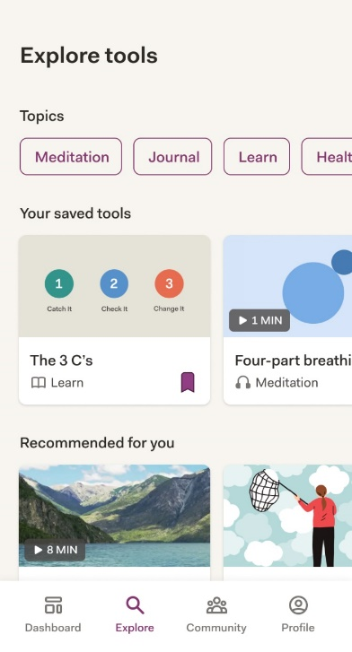

Self Care: On-demand help for stress and emotional well-being
Health Management | Behavioral Health Solutions
Features:
24/7 self-paced digital program with no out-of-pocket member costs
Mental health clinical assessments* help users track behaviors over time (PHQ-9, GAD-7, WHO-5)
Evidence-based mental health support including assessments, trackers, mental health skills and tools, collections and communities
Measurable outcomes:
Helped to improve mood, worry and stress scores for individuals using our Self Care app¹
Available via app or web experience on mobile device, tablet or computer
Ready to get started?
Visit ableto.com/begin Company access code: benefitsplus.
4.5/5-star rating on the App Store^{®2}

Slide 31
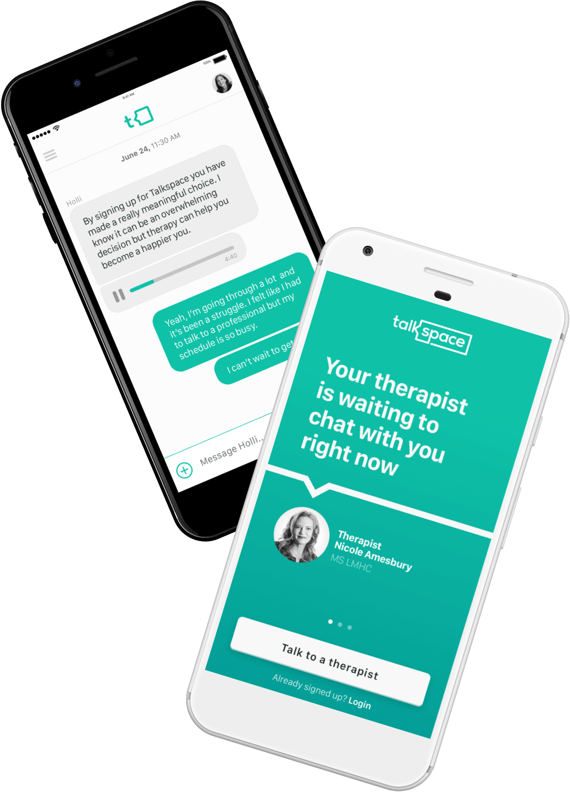


Talkspace
Talkspace lets you speak your mind
With Talkspace online therapy, you can regularly communicate with an in-network therapist safely and securely from phone or desktop.
  Message a licensed therapist 24/7.
  Covered under your Behavioral Health Benefits
  Use online matching tools to find the right provider for you.
  Start therapy within hours of choosing your provider.
  Schedule live video sessions when needed.
Available to UHC members as a network provider at $0 cost (PPO Plan) and ~$100 for HDHP Plan members).

Slide 32

Maven Clinic
Your Personal Guide to Parenthood! Dentsu offers extended access to Maven for support through preconception and fertility, pregnancy, postpartum, adoption, surrogacy, returning to work after parental leave, and pediatric support up until your child's 10th birthday. Use Maven for 24/7 virtual access to providers, specialists, coaches, and trustworthy content tailored to your experience. All at no cost to you!
Unlimited coaching and education from over 30 specialties of women’s and family health providers through video chat and messaging
Your own Care Advocate who can help you find support, navigate your benefits, and understand your health bills
Personal referrals to high-quality fertility clinics, childcare facilities, and in-person care when needed
Easy reimbursement for eligible adoption and surrogacy expenses through Maven Wallet
Get Started
You can register for Maven at any time during your adoption or surrogacy journey. To register and learn more, visit http://mavenclinic.com/register.
4

Slide 34

Work Perks and Convenience Tools
Lulafit is a free digital platform that connects you to a mix of daily workouts, a curated library of lifestyle guides and on-demand activities, and weekly events like happy hour trivia.
Farmers can help you find affordable solutions for your auto and home insurance needs.
PetFirst pet insurance (offered through MetLife) can help avoid potentially expensive vet bills for your pet.
Plum Benefits offer discounts, special offers to top attractions, theme parks, movie tickets, sporting events and more!
More
Impact
More
Acceleration
More
Opportunity

Slide 35
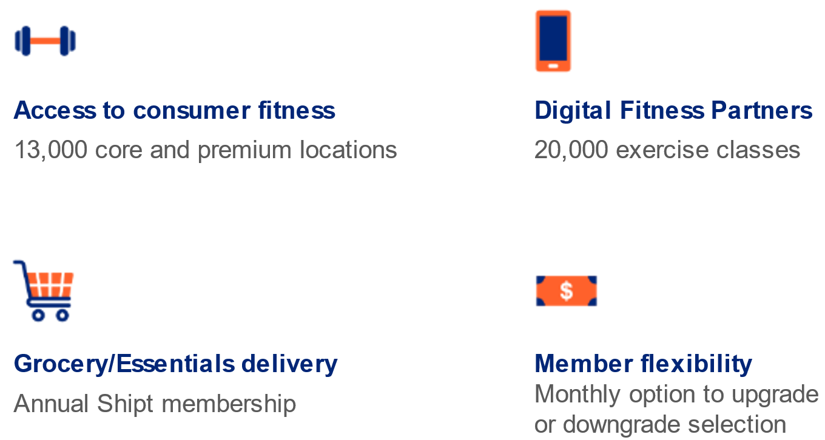
One Pass
A complete subscription based and well-being network to support a healthier lifestyle.
You’ll be able to enroll once you are enrolled in medical, if you choose not to enroll in the medical plan, please refer to the FAQ page to learn about eligibility and how to get started with One Pass.

Slide 36
One Pass Tier Options
A variety of membership options to find your fit
Digital
Classic
Standard
Premium
Elite
$5/month
$5 enrollment fee
$25/month
$25 enrollment fee
$59/month
$25 enrollment fee
$99/month
$25 enrollment fee
$139/month
$25 enrollment fee
Access to more than 28,000 on-demand and livestreaming classes
Customizable workout builders
Access to 10,000+ fitness locations
Multi-location access at no additional cost
Grocery and household essentials delivery
Includes digital tier
Access to 11,500+ fitness locations, including boutique studios
Multi-location access at no additional cost
Grocery and household essentials delivery
Includes digital tier
Access to 13,500+ fitness locations, including boutique studios
Multi-location access at no additional cost
Grocery and household essentials delivery
Includes digital tier
Access to 14,000+ fitness locations, including boutique studios
Multi-location access at no additional cost
Grocery and household essentials delivery
Includes digital tier
All One Pass memberships offer flexibility. You can change member tiers monthly, and you can cancel your membership at any time by giving a 30-day notice. Join as many gyms as you like within a given tier at no additional cost. Network partners and number of fitness locations in each tier subject to change.

Slide 37

Bright Horizons Care Advantage
Start Making your Life Easier.
  Register online at: clients.brighthorizons.com/dentsu
  Download the Back-Up Care mobile app
  Access ID: dentsu
  Access PW: backup4you
  Questions? Call 877.242.2737
Bright Horizons has added additional programs to help support you and your family in a virtual learning environment.
These enhancements include:
Ability to connect with ‘educational caregivers’ to assist with guided learning
Higher discounts with tutoring partners
Additional tutoring resources to help your children adapt
Reserve Back-Up Care Right From Your Phone
When care breakdowns occur, you need to reserve and confirm care – fast. Get access to a streamlined reservation process and a guided process to use your Bright Horizons benefits with the Back-Up Care mobile app, available through the AppStore or Google Play.

Slide 38
More Information?
Make an appointment with a Benefit Counselor at dentsu.myenrollmentinfo.com
Call the BenefitsPlus Solution Center - (855) 326-7870 from 9AM – 6PM Mon-Fri
For help accessing your benefit account and/or enrolling
If you have a qualifying life event
If you need assistance with your benefits or have plan questions
To Enroll: www.dentsubenefitsplus.com
Call Schwab Retirement Services - (800) 724-7526. 7AM – 10PM Monday – Friday
For questions about the BenefitsPlus 401(k) plan
For questions on rollovers from your prior employer’s 401(k) Plan

